Slide 1
Aloha!
Scott Pauli
Executive Director
www.gohawaii.com/ca
agents.gohawaii.com

Slide 2
Notes:
Welcome to the island of Hawai'i, the youngest and largest of the Hawaiian islands.

Slide 3
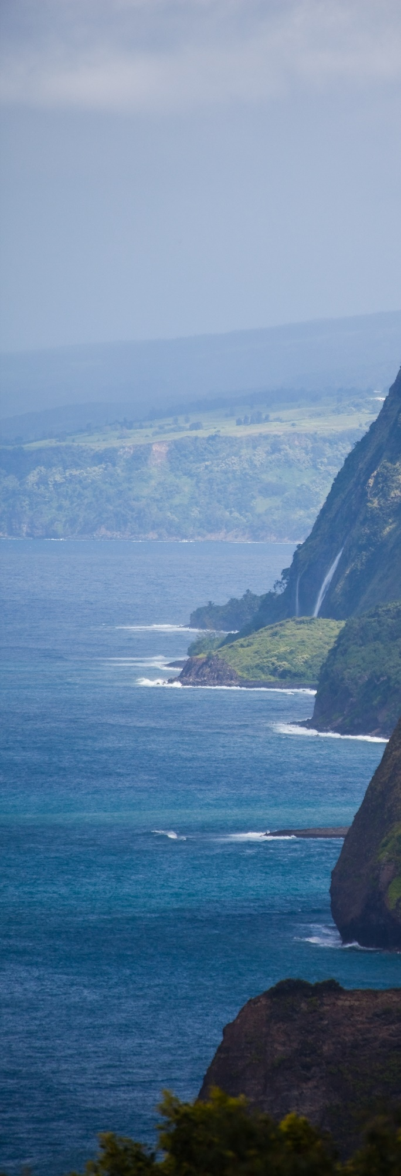
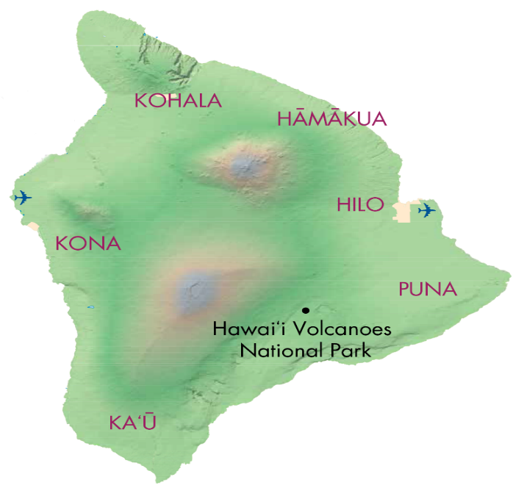
Airlift
Pololu Valley
Waipi‘o Valley
KOA
Chicago, IL
Denver, CO
Las Vegas, NV
Los Angeles, CA
Oakland, CA
Phoenix, AZ
Portland, OR
San Diego, CA
San Francisco, CA
San Jose, CA
Seattle, WA
Vancouver, B.C., Canada
Haneda, Japan
Narita, Japan
Hapuna
Beach Park
Kohala Coast
Maunakea
Akaka Falls
KOA
ITO
Rainbow Falls
Kona Coast
Maunaloa
Notes:
- Two airports to welcome our guests
- KOA for U.S. Domestic and International (including our seasonal Canada service)
- ITO currently services inter-island flights

Slide 4
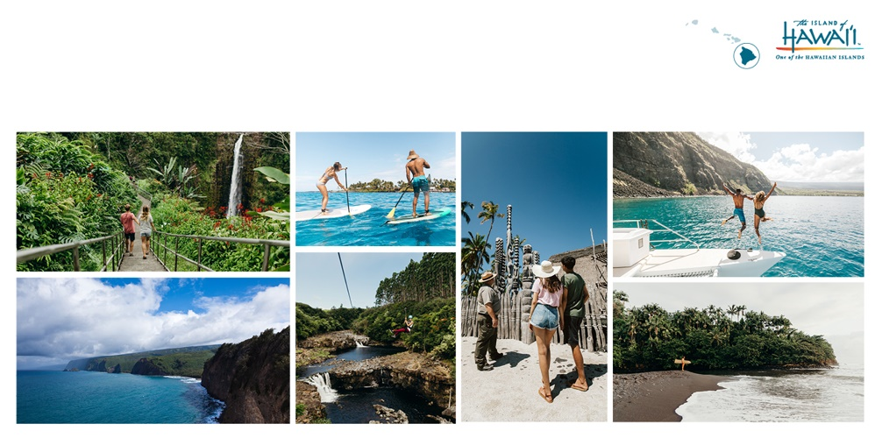
Living Culture. Accessible. Active. Exploration. Saturated Blue/Greens/Blacks.
Boundless. Volcanoes.
Experience of a lifetime / Trips within their vacation / Immerse in history and culture

Slide 5
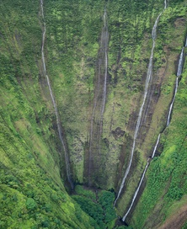
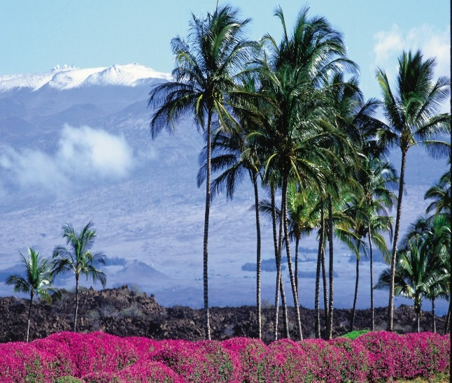
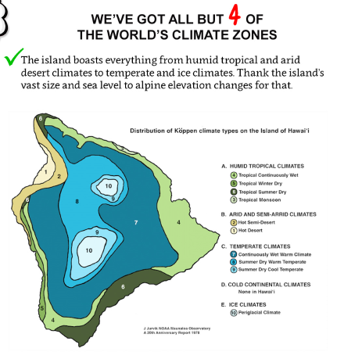
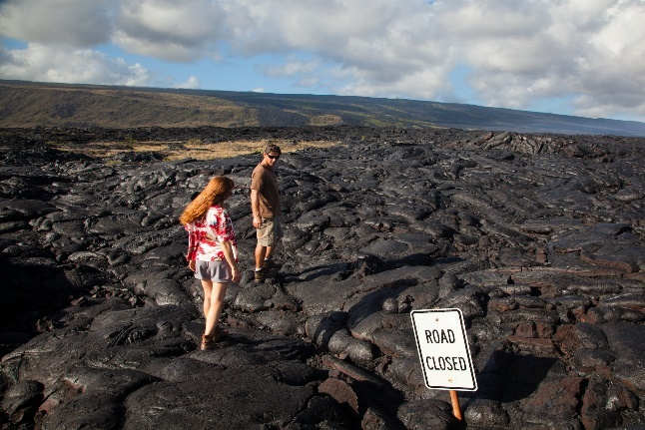
Diverse in Climate
d
Notes:
Hawaii Island is very diverse in climate. Imagine being at the beach, looking up at Maunakea and seeing a snow-capped mountain or on the same day hiking through an arid desert region.

Slide 6
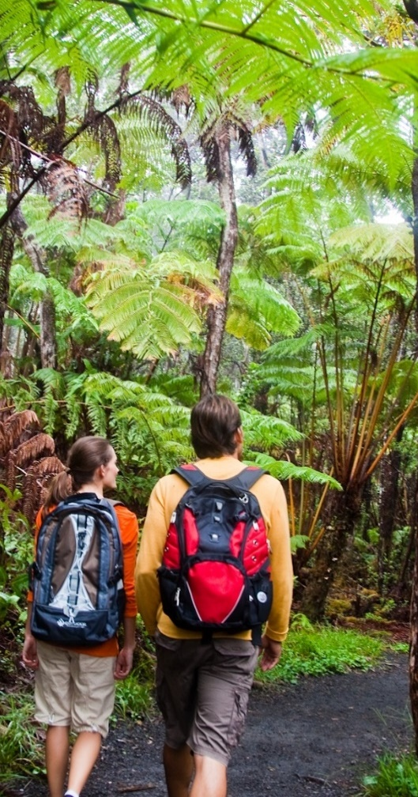
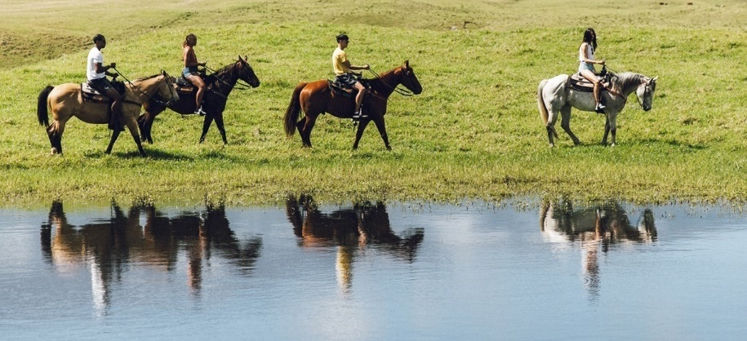
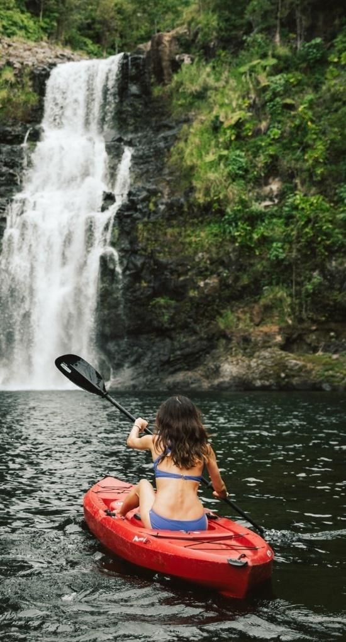
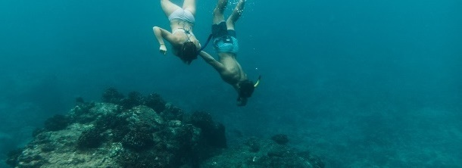
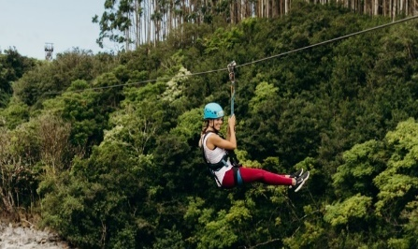
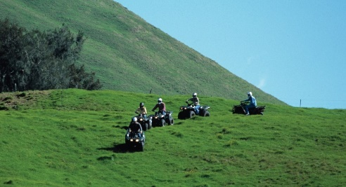
Diverse in Activities
Notes:
Our diverse climate offers diverse activities as well. We are so many outdoor adventures that will help you connect with yourself and nature. Ziplining through beautiful valleys and waterfalls. Our ocean is our underground playground.

Slide 7
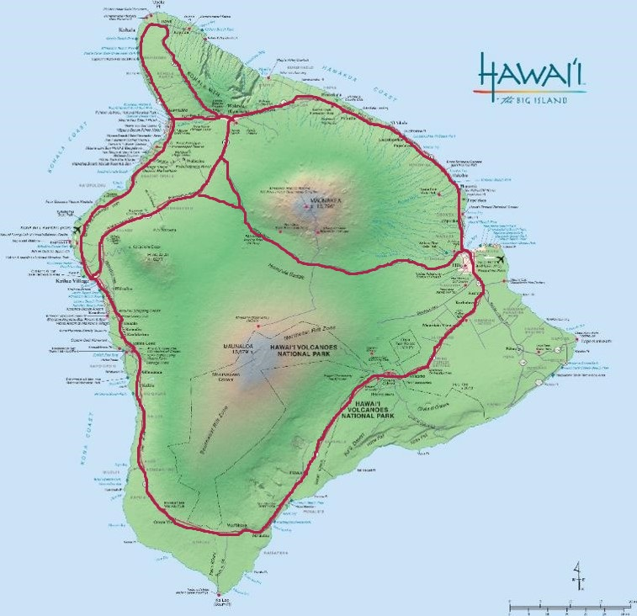
LARGEST HAWAIIAN ISLAND
Four thousand and twenty-eight [4,028]
square miles [≈10,432.5km²]; all the other Hawaiian islands can fit on Hawai‘i Island with room to spare!
Kohala Coast
DRIVE AND EXPLORE
Kona Coast to Kohala Coast
35 minutes
Kona to Hawai‘i Volcanoes National Park
2 ½ to 3 hours
Kona to Hilo
1 ½ to 2 ½ hours
Hilo to Hawai‘i Volcanoes National Park
40 minutes
Kona Coast
Hilo
Kona Coast to Kohala Coast
35 minutes
Kona to Hawai‘i Volcanoes National Park
3 hours
Kona to Hilo
1 ½ to 2 ½ hours
Hilo to Hawai‘i Volcanoes National Park
40 minutes
Hawai‘i Volcanoes National Park

Slide 8
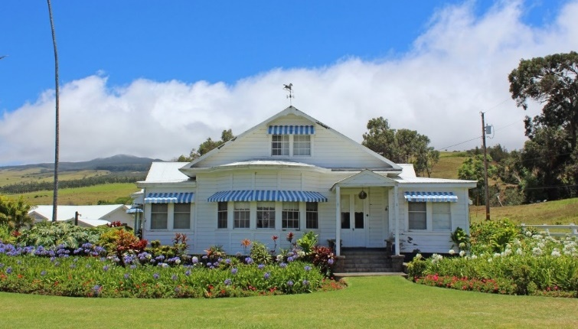
Anna Ranch Heritage Center
Kahuā Ranch
Notes:
White sand beaches include: ʻŌhaiʻula (Spencer Park), Kaunaʻoa, Hāpuna Beach State Park, Pauoa Bay (fronting The Fairmont), ʻAnaehoʻomalu Bay, Makaīwa Bay (fronting Mauna Lani).

Slide 9
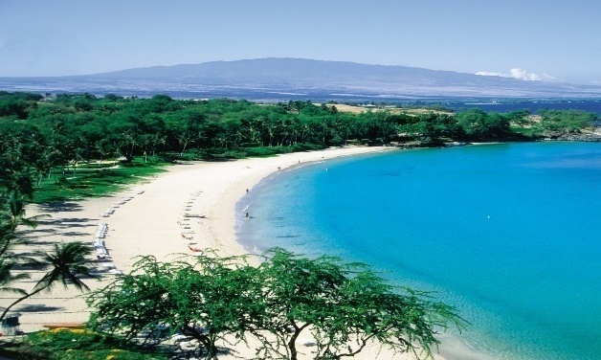
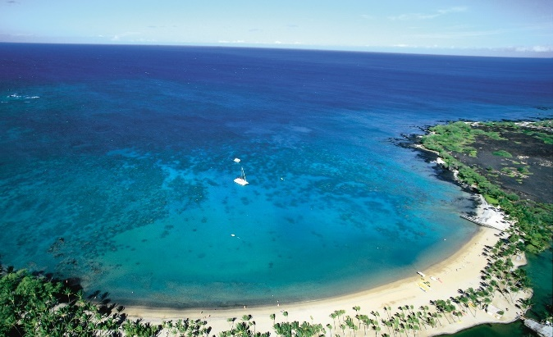
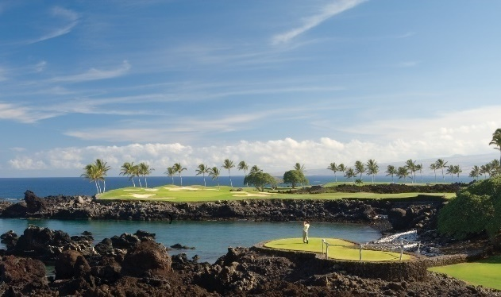
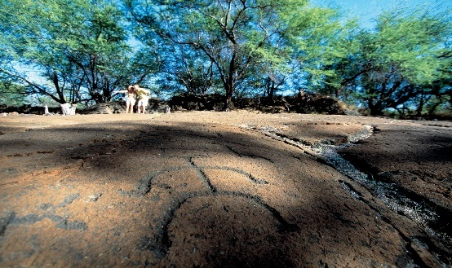
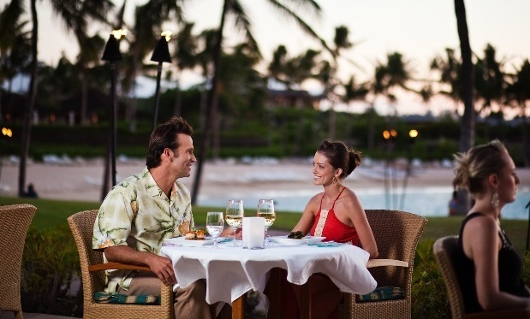
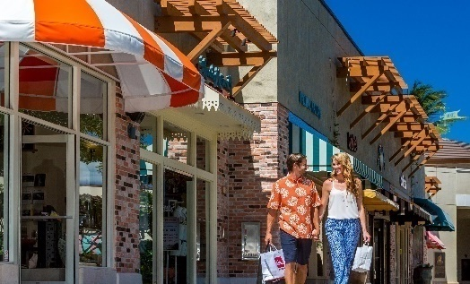
Hualalai / Kohala
Waikoloa Resort Area
Mauna Lani Resort Area
Mauna Kea Resort Area
Hualalai Resort Area
White Sand Beaches
Oceanfront Golf
Spa Retreats
Shopping & Dining
Historic Sites & Trails
Puʻukoholā Heiau National Historic Site

Slide 11
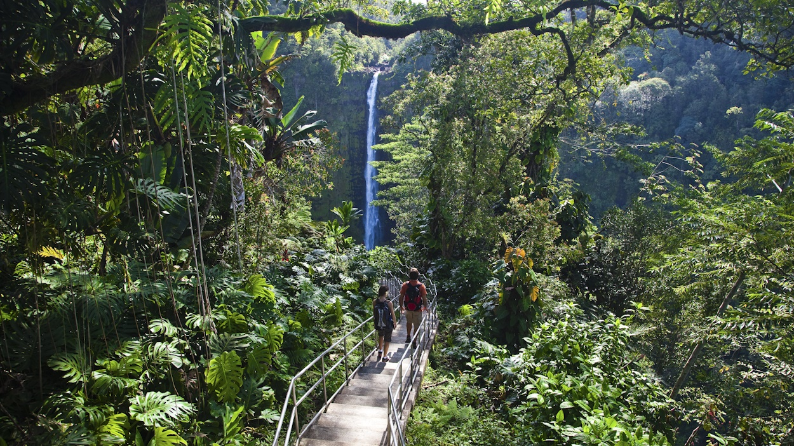
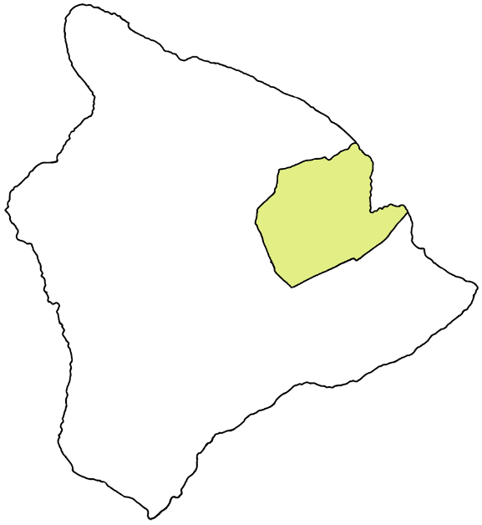
HILO
‘Akaka Falls

Slide 12
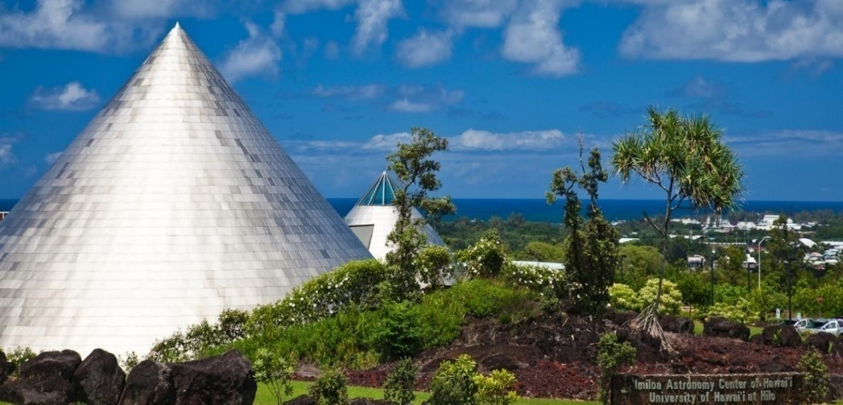
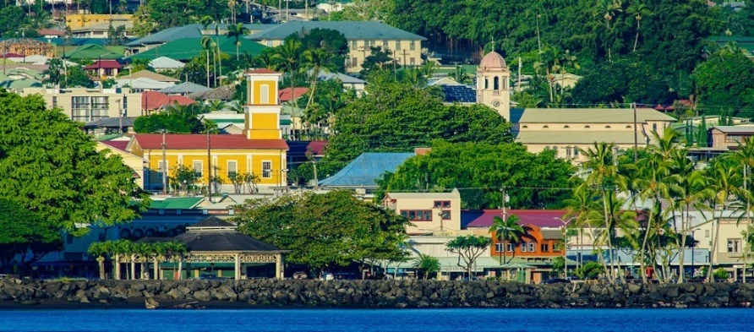
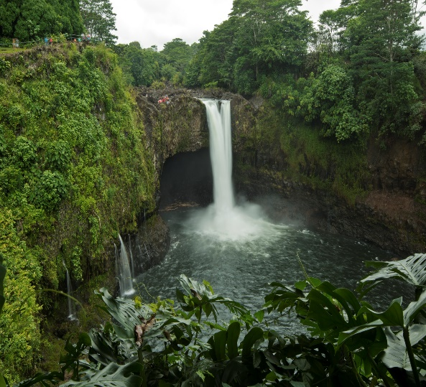
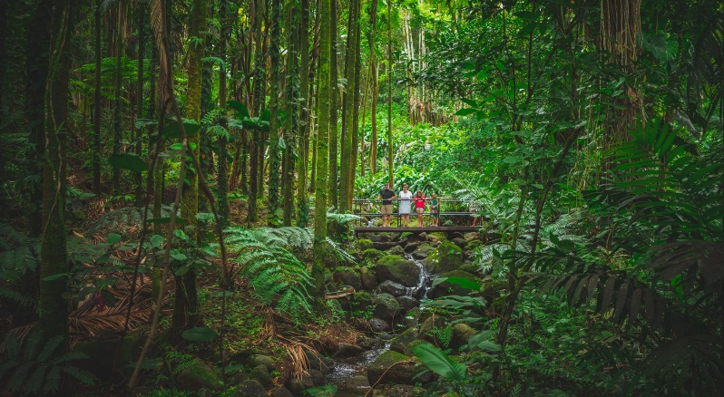
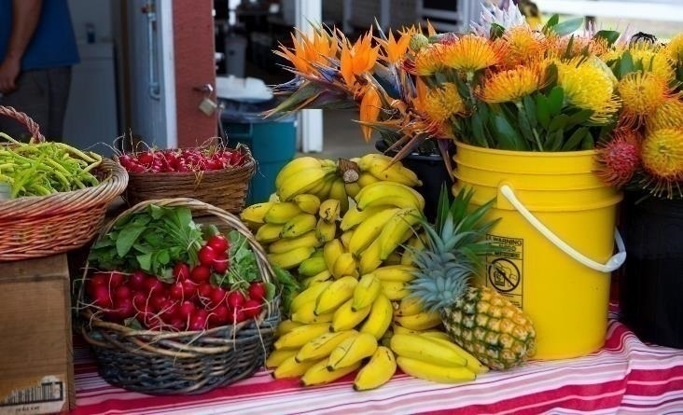
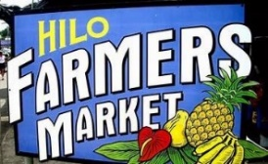
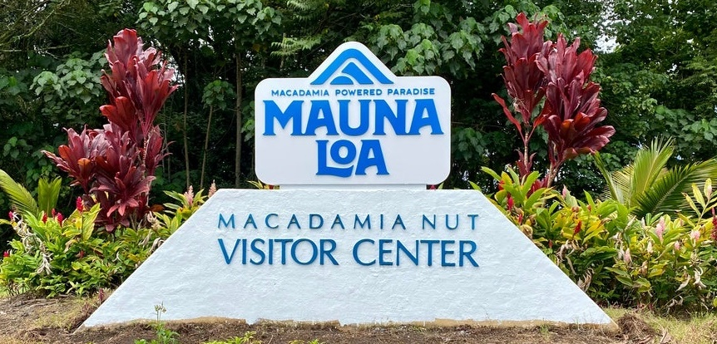
EXPLORE HILO
Gateway to Hawai‘i Volcanoes National Park
Stroll Downtown Hilo
King Kamehameha Statue
‘Imiloa Astronomy Center
Botanical Gardens
Tsunami Museum
Lyman Museum
Mauna Loa Macadamia Visitor Center
Big Island Candies
Lili`uokalani Gardens
Rainbow Falls
O.K. Farm Tour
Pana’ewa Rainforest Zoo and Gardens
Hawai‘i Tropical Bioreserve and Garden

Slide 14
Kona Airport
Ahu‘ena Heiau at Kamakahonu Bay

Slide 15
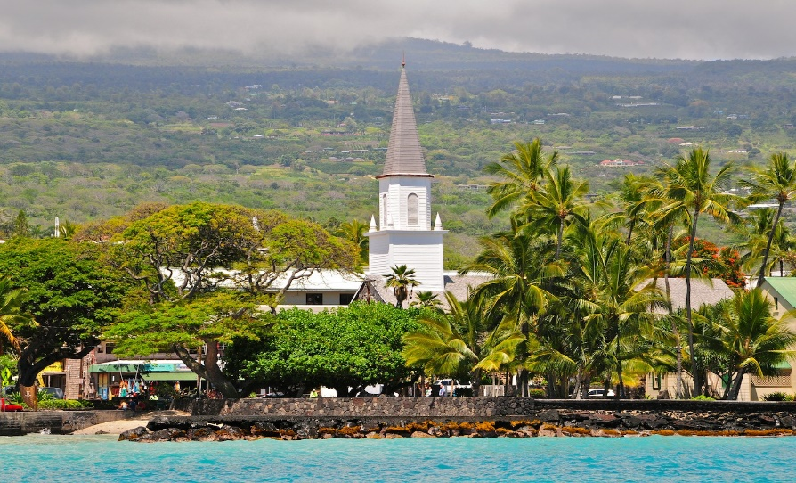
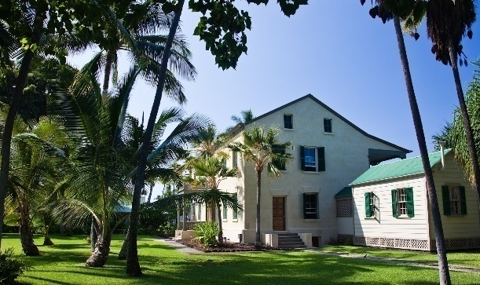
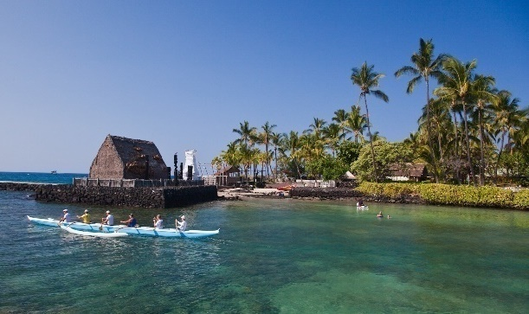
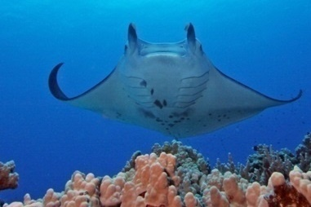
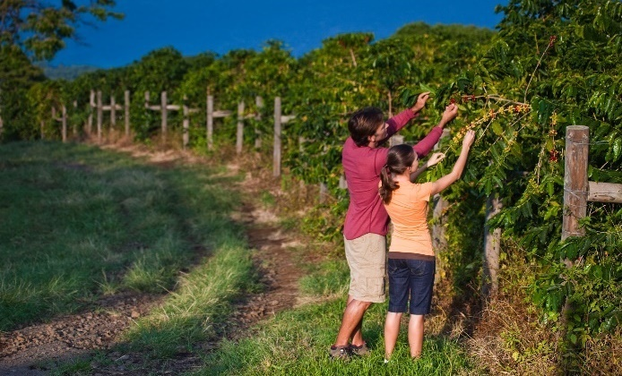
EXPLORE KONA
Stroll Ali’i Drive
Hulihe’e Palace
Mokuaikaua Church
Art galleries
Shops & restaurants
Kona Coffee Belt
Snorkeling adventures
Dinner cruises
Submarine adventure
Town Trolley

Slide 16
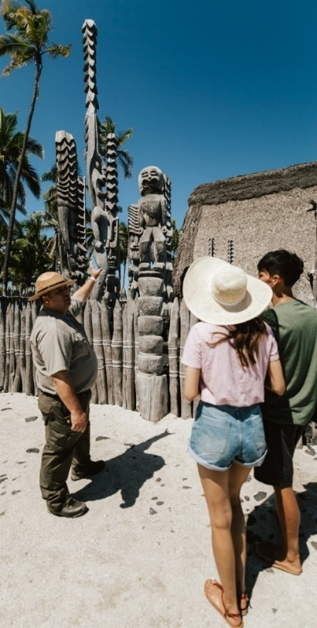
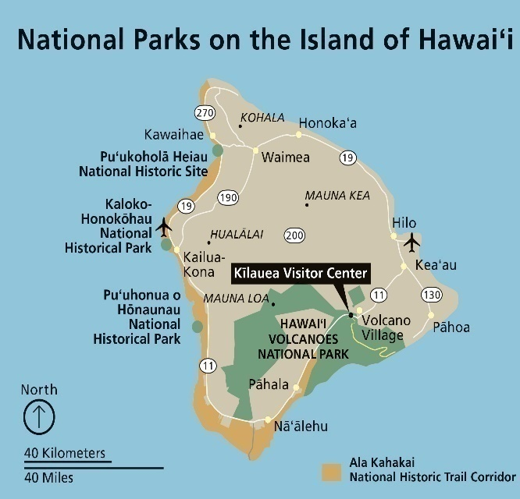
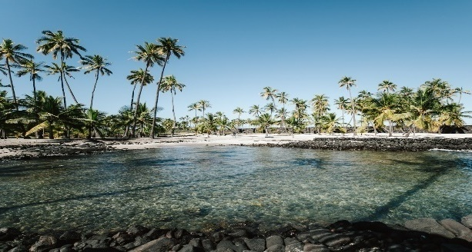
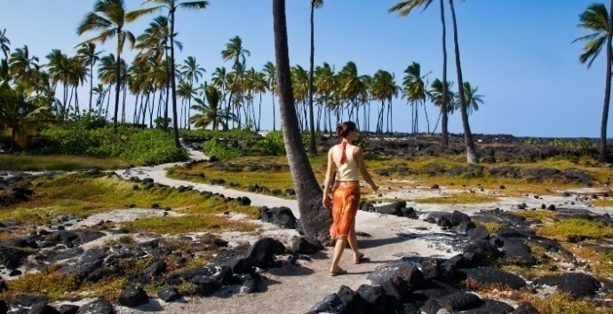
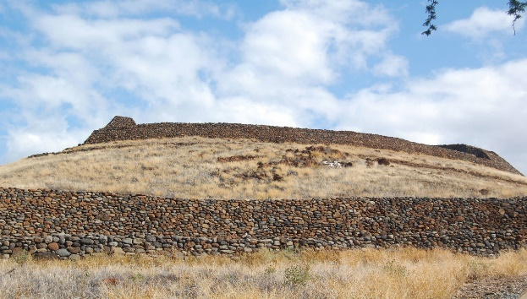
NATIONAL PARK SERVICE
www.nps.gov
National Historic Trail
Ala Kahakai
National Historical Parks / Historical Sites
Kaloko-Honokōhau
Puʻuhonua o Hōnaunau
Pu'ukohola Heiau
National Park
Hawai’i Volcanoes National Park

Slide 17
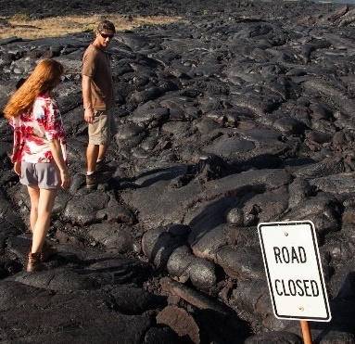
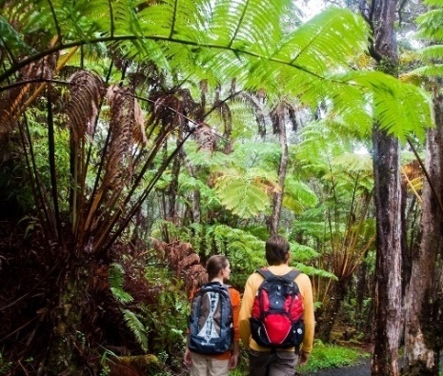
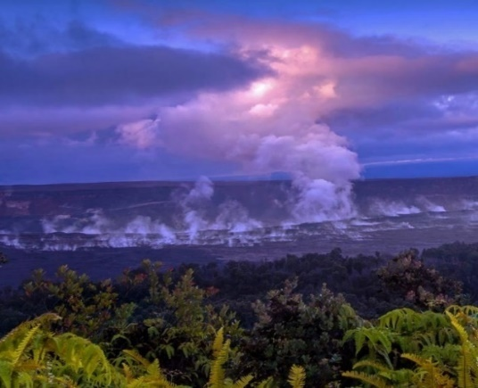
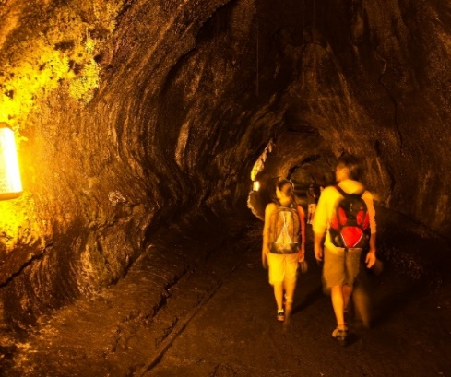
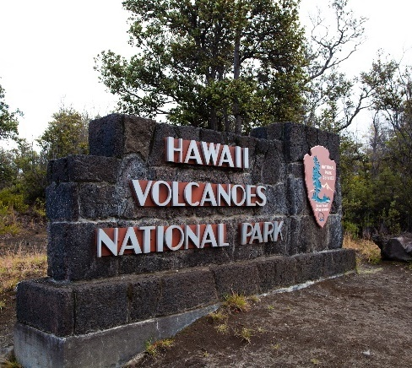
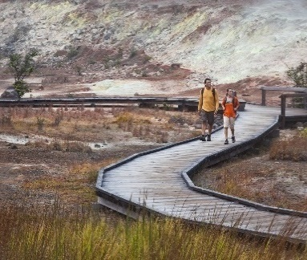
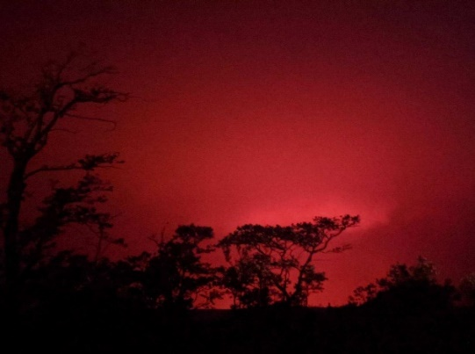
Hawai‘i Volcanoes National Park
www.nps.gov/havo
Current status: INACTIVE
150+ miles of hiking trails
Nāhuku (Thurston Lava Tube)
Steam vents
UNESCO World Heritage Site
International Biosphere Reserve
Open 24 / 7

Slide 18
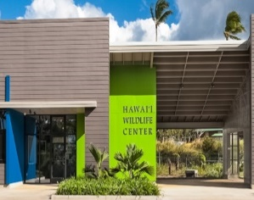
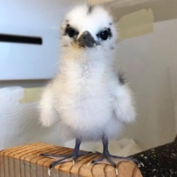
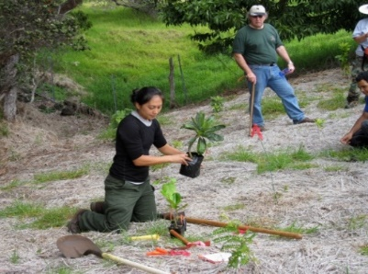
Mālama Hawai‘i
ManaUpHawaii.com
HawaiiFarmTrails.com

Slide 19
Festivals & Events
GoHawaii.com/events
April-June
Merrie Monarch Festival
Big Island Chocolate Festival
Hawai'i Kuauli Pacific & Asia Cultural Festival
King Kamehameha Day Celebration
July-September
Queen Lili'uokalani Canoe Race
Hawaiian Slack Key Guitar Festival
Aloha Shirt Festival
October-December
Ironman World Triathlon Championship
Hawai’i Food & Wine Festival
Kona Coffee Cultural Festival

Slide 22
Mahalo!
Scott Pauli
Executive Director
ONLINE RESOURCES
gohawaii.com/ca
agents.gohawaii.com
gohawaii.com/malama
gohawaii.com/events

