Slide 2
15 % of Hawaii’s total visitor economic activity.
Waikiki is 35 % of Hawaii’s total visitor economic activity
$ 9-11 million daily loss

Slide 3
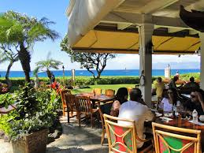
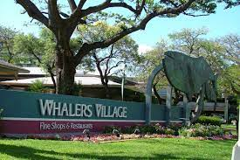
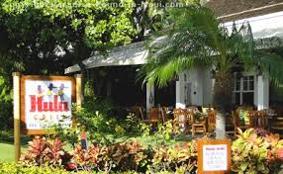
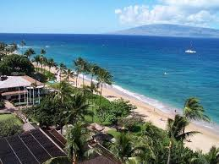
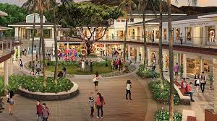
Re-Open Update
As of November 1, 2023 all of West Maui north of Lahaina is open.
Kaʻanapali Resort currently housing residents- check availability

Slide 4
How to Visit Maui with Respect & Compassion
Pack patience and grace
Expect to wait for longer than you’re used to for food or other services
Do not enter the impacted area of Lahaina Town or take photos of the area even from afar
Understand the current situation and that their travel experience may be slightly different than what they are accustomed to
Support local business
Visit MauiNuiFirst.com – ways to eat, shop, play, stay and support local
Do not ask about a resident’s personal experience with the disaster.
“Were you impacted by the fire?” may be intended to be supportive, many are not ready to share
If you come across a memorial service or other private gathering, leave the area immediately – do not take photos or videos.

Slide 6
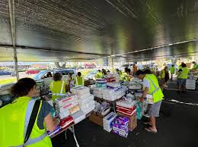
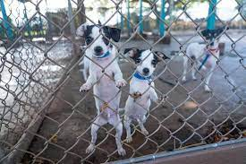
How you can mālama (to care for) Maui Nui
Feed My Sheep Mobile Food Distribution Sites:
Kahului
Wailuku
Maui Humane Society: mauihumanesociety.org

Slide 7
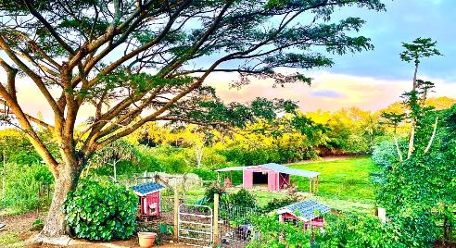
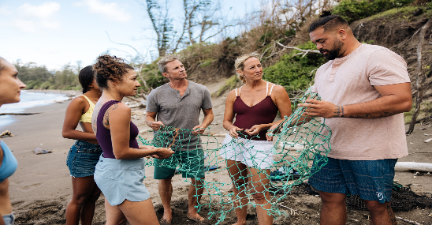
Other ways you can mālama (to care for) Maui Nui
Beach cleanups
Reforestation
Keālia Pond National Wildlife Refuge
Leilani Farm Sanctuary
Leilani Farm Sanctuary
Reforestation
Maui sewing hui
Bamboo Forest
Keālia Pond National Wildlife Refuge
Beach cleanups
Learn more at gohawaii.com/malama

Slide 8
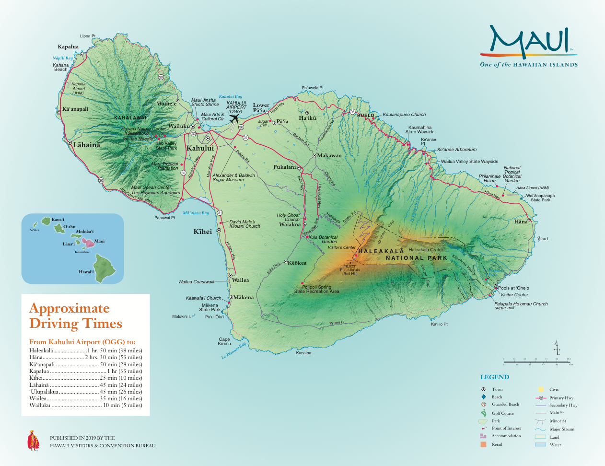
Central Maui
West Maui
East Maui
South Maui
Maui sewing hui

Slide 9
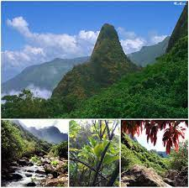
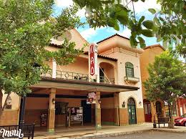
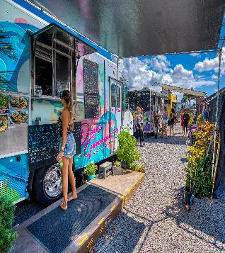
Central Maui
Kahului Airport - OGG
Hale Hōʻikeʻike (House of Display) Bailey House Museum

Slide 10
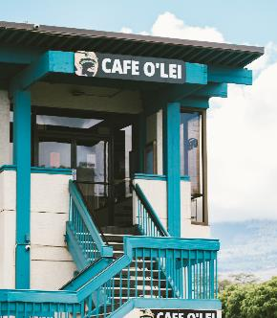
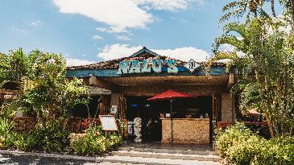
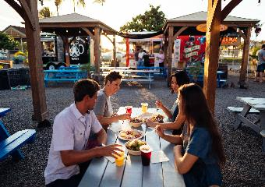
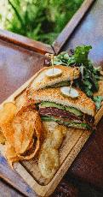
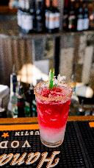
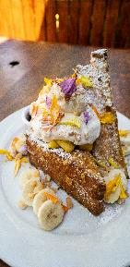
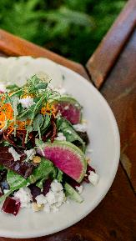
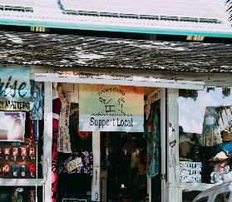
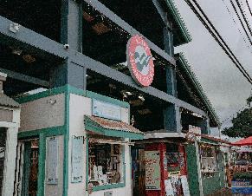
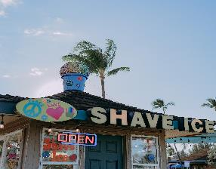
Kīhei

Slide 11
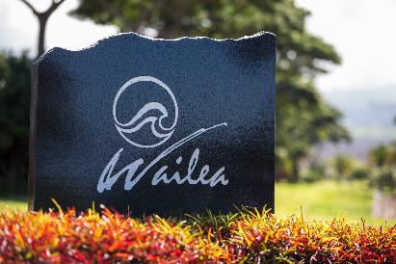
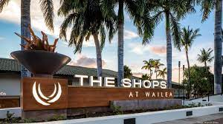
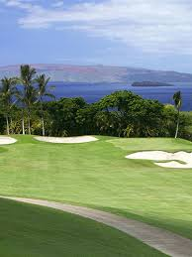
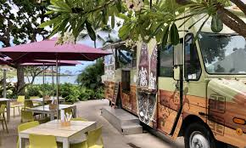
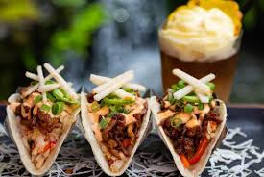

Slide 12
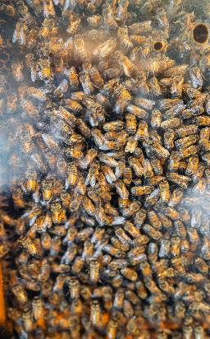
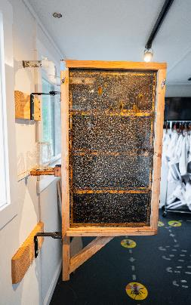
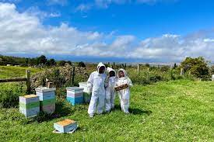
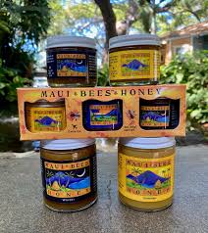
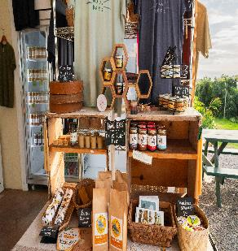
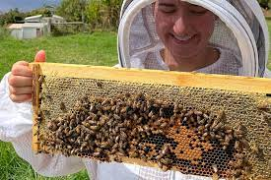
Maui Bees Tuesday- Saturday 8:30 am – 5 pm Closed Sunday & Monday Visit: mauibees.com

Slide 13
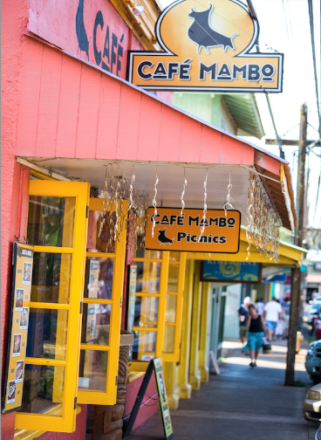
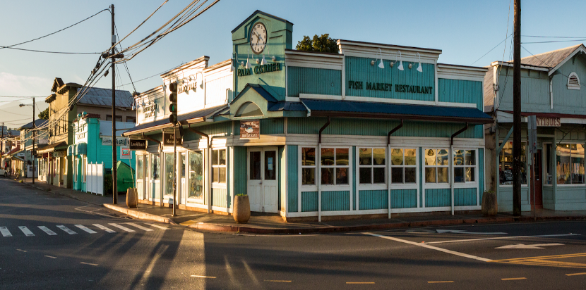
Pāʻia
Pāʻia
A historic town with colorful rustic storefronts on Mauiʻs north coast.

Slide 14
Road to Hāna
Road to Hāna has 620 curves and 59 bridges
East Maui

Slide 15
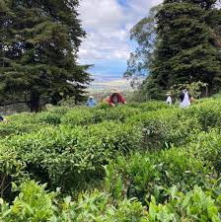
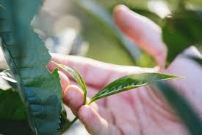
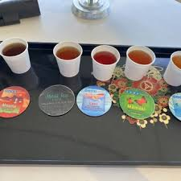
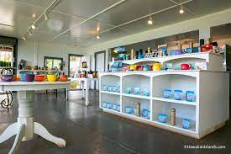
Maui Tea Farm
In addition to tea, the farm has planted oranges, tangerines, lemons, apples, pears, lychees, avocado, olives, blueberries, squash, kale, potatoes, radishes, and arugula.
Mondays – Saturdays from 9:30 am to 4:30 pm.
Visit: MauiTeaFarm.com

Slide 16
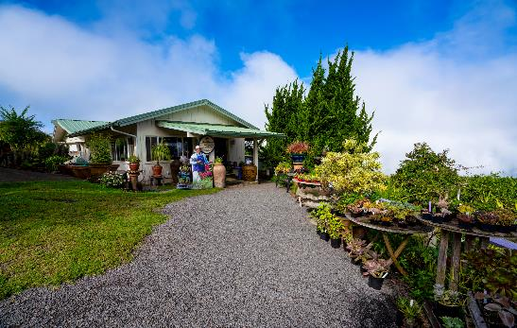
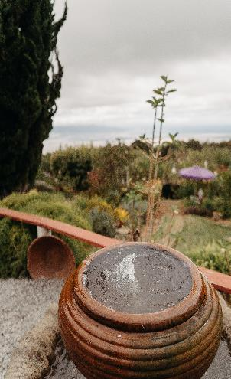
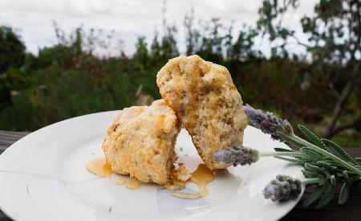
Kula Lavender Farm
Friday-Monday 10 am – 4 pm
Closed Tuesday- Thursday
Visit: aliikulalavender.com
Donation to Maui Food Bank

Slide 17
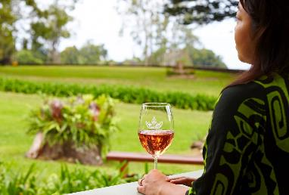
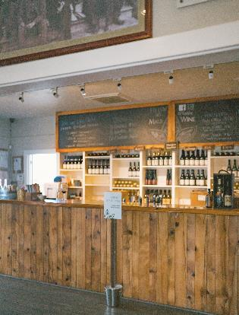
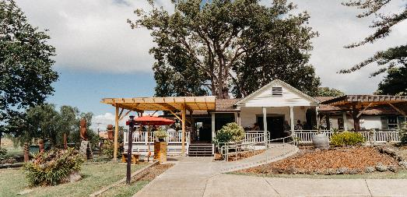
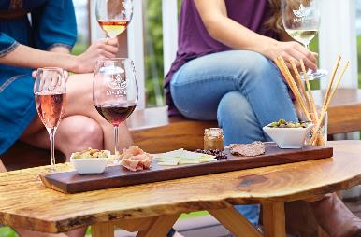
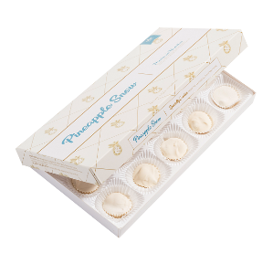
Maui Wine
Opens 11 am – 5 pm Tuesday- Sunday : Closed Monday
Visit: mauiwine.com

Slide 18
FESTIVALS AND
SPORTING EVENTS

Slide 19
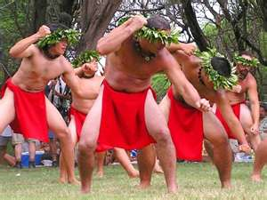
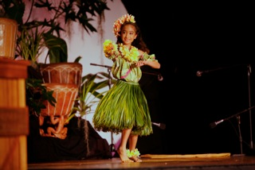
Cultural Festivals
Celebration of the Arts: April
Taro Festival (Hāna): April
King Kamehameha Celebration: June
Festivals of Aloha: September
Hula O Nā Keiki: November

Slide 20
Festivals and Sporting Events
Sentry Tournament of Champions- January
Maui Ag Festival – June
Kapalua Wine & Food Festival – June
Maui Film Festival – June
Lānaʻi Pineapple Festival – July
Maui Jim Maui Invitational- November – Oahu
Hawaiian Airlines Made in Maui County Festival - November

Slide 21
New Properties
Kihei
Maui Coast Hotel is adding 162 room hotel expansion. 6 story building. Currently Maui Coast have 265 rooms.
Kahului
Maui Palms is now going to be called Maui Palms Hampton Inn and Suites by Hilton. Completion date is 2025. There will be 136 rooms. Geared towards interisland business.

Slide 22
County of Maui
Mineral-Only Sunscreen Ordinance
Keep our ocean healthy by using sunscreen labeled “Mineral-Only” available at all Maui retailers.
October 1,2022- law bans non-mineral sunscreens. Any sunscreen containing active ingredients other than Zinc Oxide or Titanium Dioxide.
20 Mineral-Only sunscreen dispensers are installed at Maui County beaches and parks.

Slide 23
Haleakalā (House of the Sun) Reservations required for sunrise recreation.gov
Advance Reservations Required
Waiʻānapanapa State Park
(Glistening waters)
Gowaianapanapa.com
ʻĪao Valley State Monument Park
Hawaii.gov

Slide 24
Mālama Maui County Pledge
Video

Slide 25
OUR MISSION
To enrich Hawai‘i and its people.
•
OUR VISION
To attract visitors who will leave this place better than when they arrived.
MĀLAMA HAWAI‘I

Slide 26
Lahaina
Banyan Tree
Baldwin House

Slide 27
MAHALO
June Pagdilao
Director Sales
June@mauivb.com

