Slide 1
Karishma Chowfin, Director of Sales
O‘ahu Visitors Bureau

Slide 2
SIX UNIQUE VISITABLE ISLANDS

Slide 4
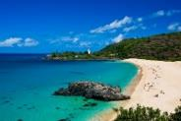
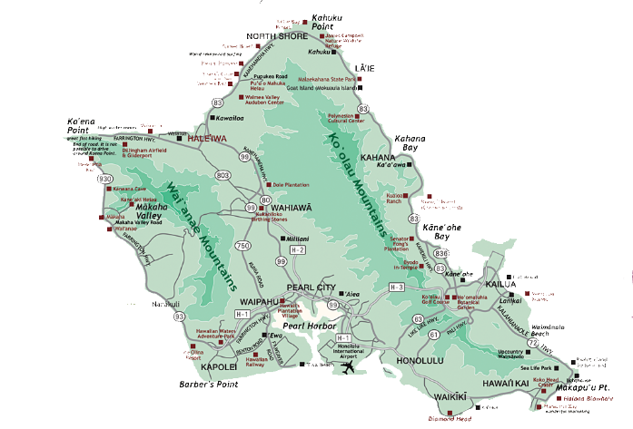
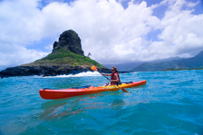
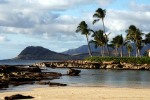
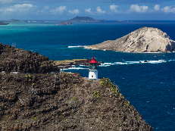
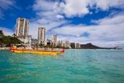
THE HEART OF Hawai‘i
Island of O‘ahu
“Town” & “Country” Experiences
(4) Resort Experiences
So Much More Hawai‘i
112mi Of Accessible Shoreline
Hotel Inventory: 31,348 Hotel Rooms
Variety of accommodations: Historical Hotels |International Brands | Luxury Brands | Condominiums & Affordable Options
NORTH SHORE Turtle Bay RESORT AREA
WINDWARD COAST
LEEWARD COAST KO‘OLINA RESORT AREA
EAST SHORE KĀHALA RESORT AREA
SOUTH SHORE WAIKĪKĪ RESORT AREA
Notes:
“Town & Country”
The most amount of swimmable beaches in the entire state of HI – over 123miles of swimmable coastline

Slide 5
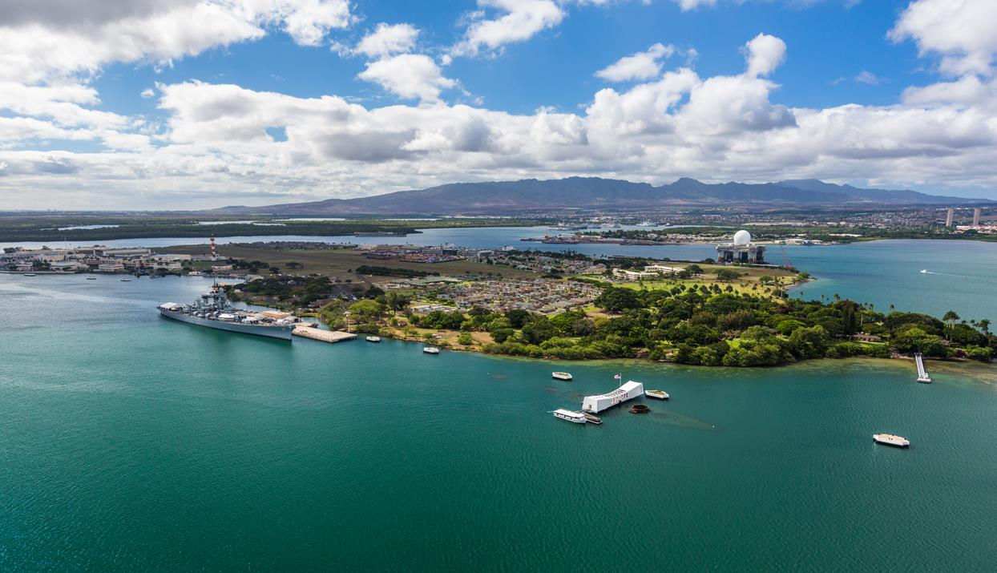
PEARL HARBOR NATIONAL MEMORIAL
www.pacifichistoricparks.org
USS ARIZONA MEMORIAL | BATTLESHIP MISSOURI MEMORIAL |
USS BOWFIN SUBMARINE MUSEUM & PARK | PACIFIC FLEET SUBMARINE MUSEUM – BRAND NEW! | USS OKLAHOMA MEMORIAL |
PEARL HARBOR AVIATION MUSEUM
USS Arizona Memorial
www.recreation.gov
Touchless ticketing system. Tickets MUST be reserved ahead of time prior to arrival. Present a paper copy or digital reservation confirmation for validation. Plan to arrive 1hr prior to program time

Slide 6
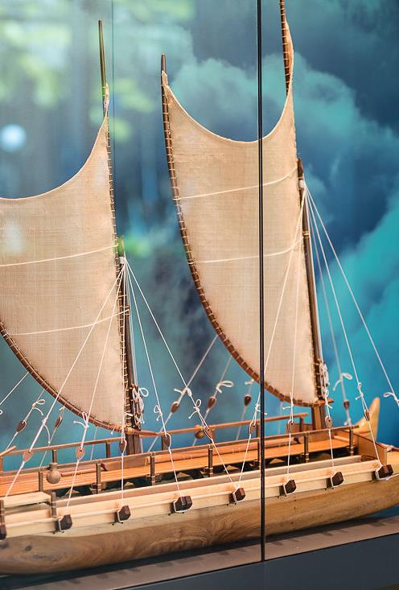
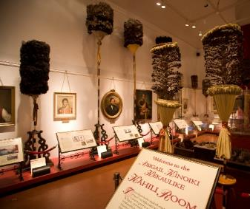
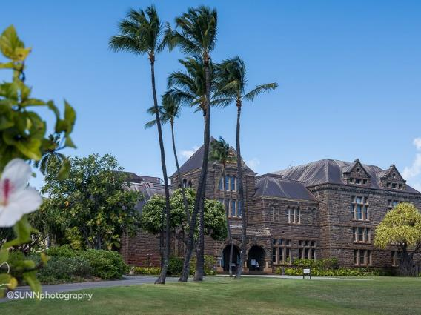
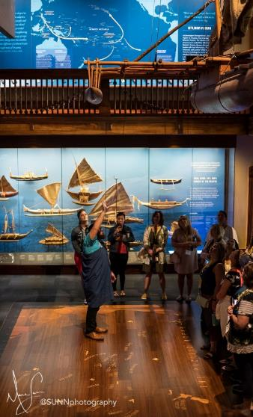
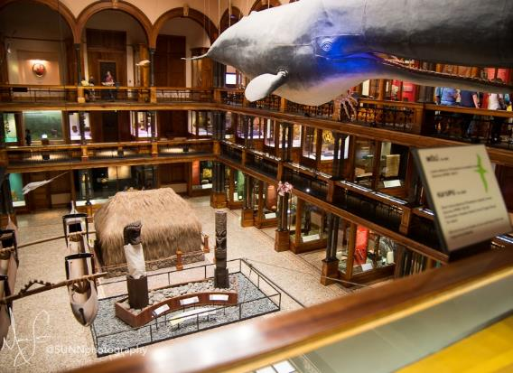
BERNICE PAUAHI BISHOP MUSEUM bishopmuseum.org
Open 9:00am – 5:00pm Daily
7 days a week
Smithsonian of the Pacific” Experience the history, arts and culture of the Hawaiian people
Hawaiian Hall | Pacific Hall | Castle Hall | Planetarium | Science Adventure Center

Slide 7
BERNICE PAUAHI BISHOP MUSEUM
bishopmuseum.org

Slide 8
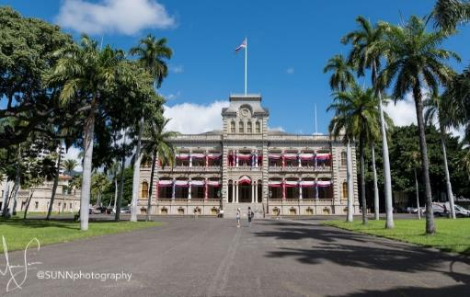
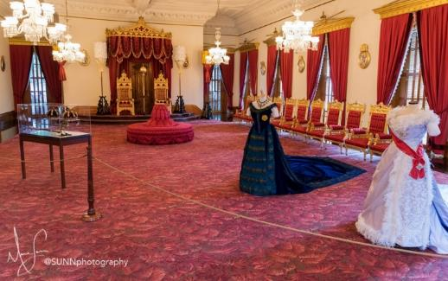
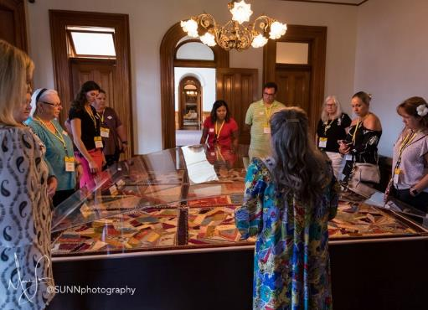
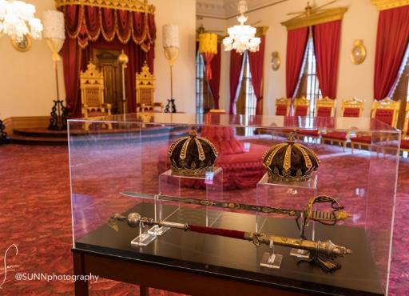
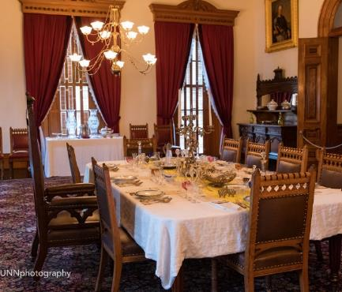
SOUTH SHORE – ‘Iolani Palace www.iolanipalace.com

Slide 9
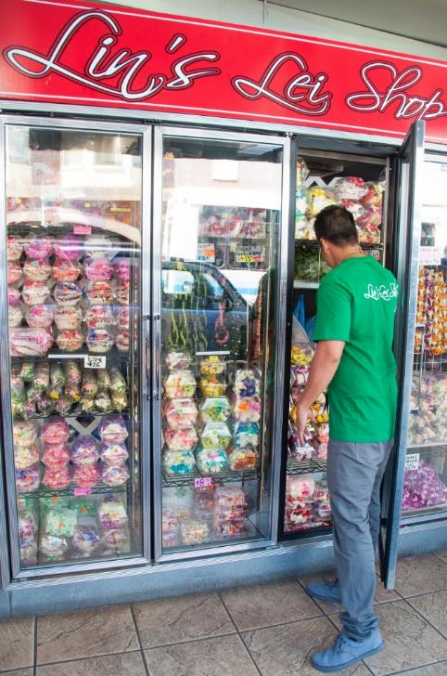
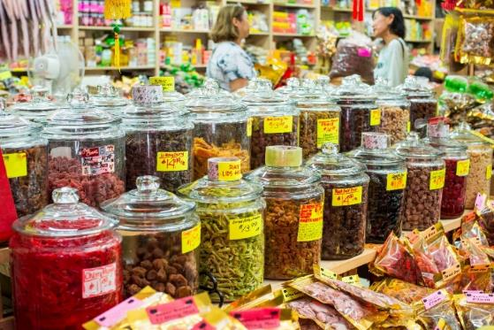
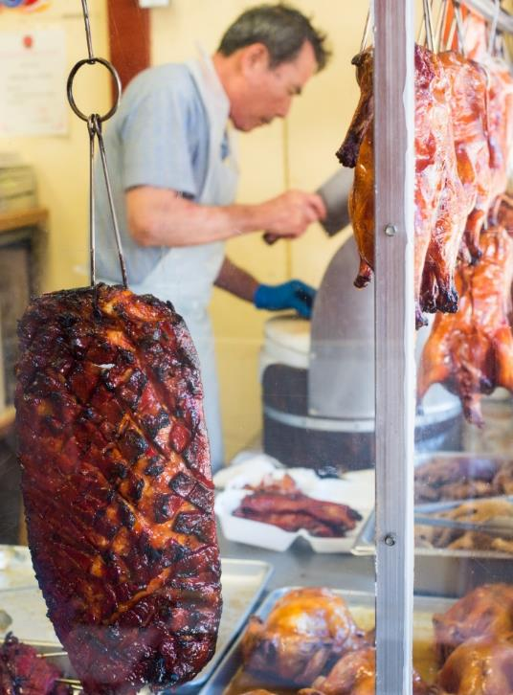
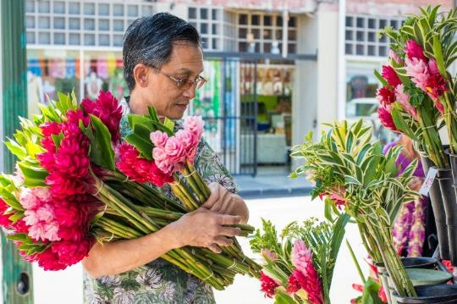
SOUTH SHORE – Arts District / Chinatown
Listed in the National Register of Historic Places
Notes:
Founded in the 1840s when thousands of immigrants came to the island to work on sugar plantations, Honolulu’s 36-acre Chinatown burned down in 1900 in what has come to be known as the Great Chinatown Fire. With resilience and grit, the community rebuilt their beloved neighborhood from the ashes. In the more recent part of its 100-plus-year revival, Chinatown has become a hub of nightlife, art, food, and culture. Today, the neighborhood is listed in the National Register of Historic Places, ensuring its buildings and storefronts can’t be demolished for new development.
The mix of Chinese businesses, modern Asian-fusion restaurants, and the occasional New American joint make Honolulu’s Chinatown unique. It can be fun for visitors to experience the breadth

Slide 10
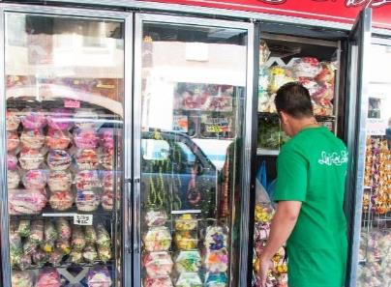
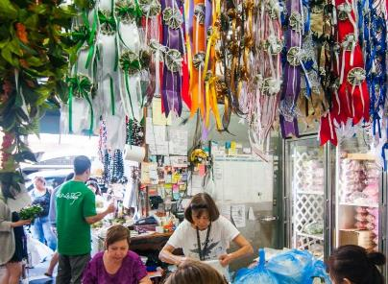
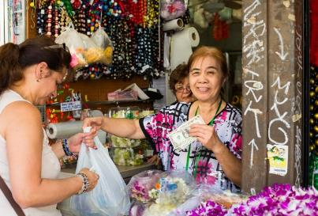
SOUTH SHORE
Arts District | Chinatown
Stroll down Maunakea Street in Chinatown to discover firsthand the art of lei making.

Slide 11
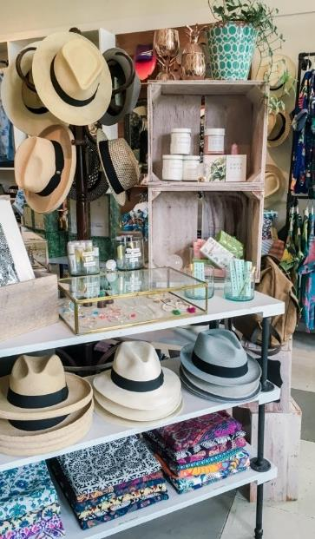
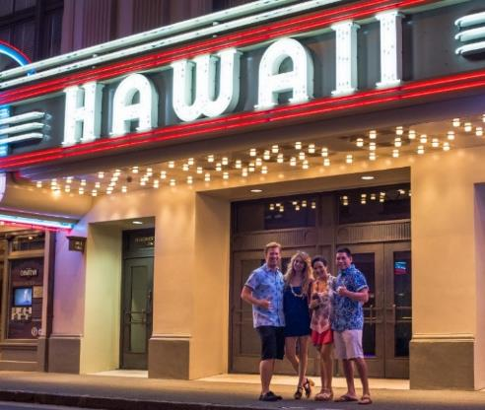
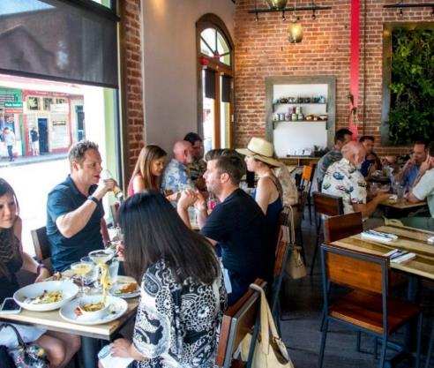

Slide 12
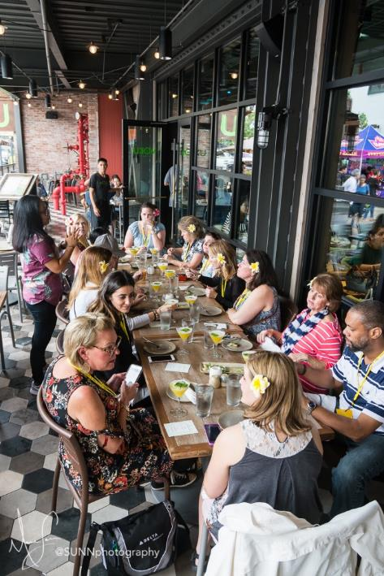
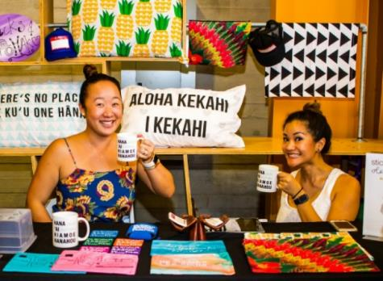
SOUTH SHORE – Kaka‘ako

Slide 13
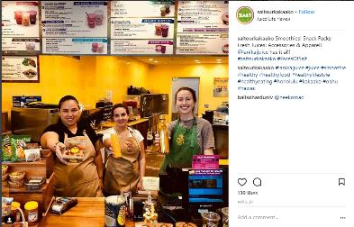
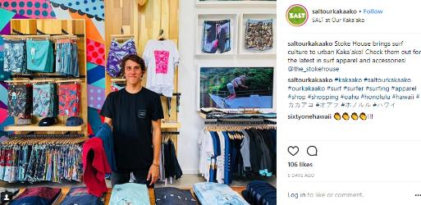
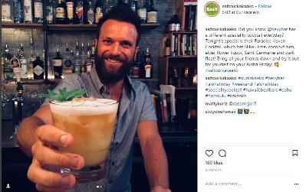
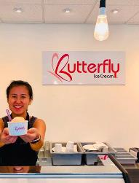
SALT AT OUR Kaka‘ako saltatkakaako.com

Slide 14
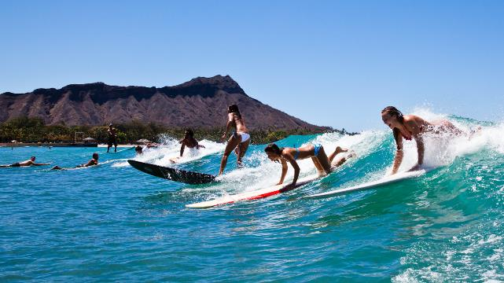
SOUTH SHORE – Waikīkī
The “Sport of Kings.” |O‘ahu, the Birthplace of Surfing | Waikīkī is the easiest place to learn | Where the “Waikīkī Beach Boys” became famous |Surfing, Stand Up Paddle

Slide 15
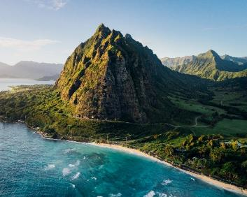
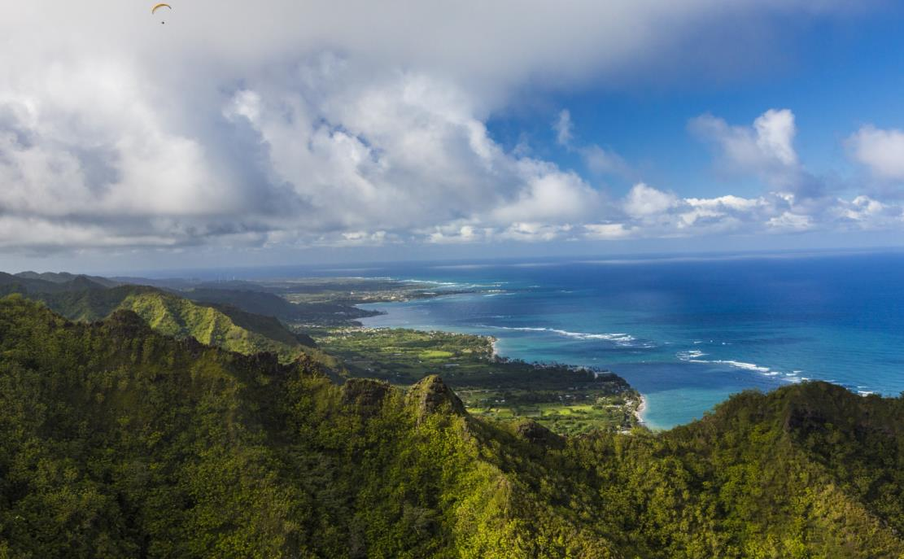
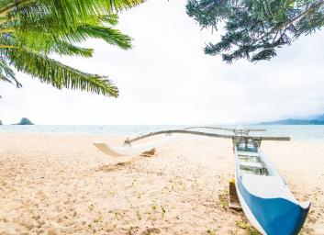
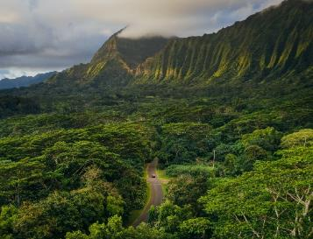
WINDWARD COAST
Secret Island – Kualoa Private Nature Reserve
Ho‘omaluhia Botanical Garden

Slide 16
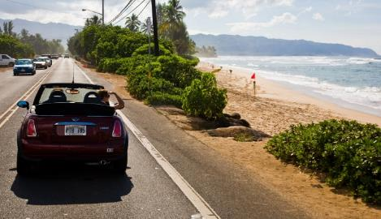
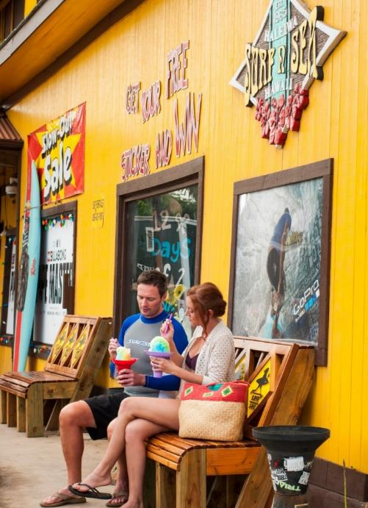
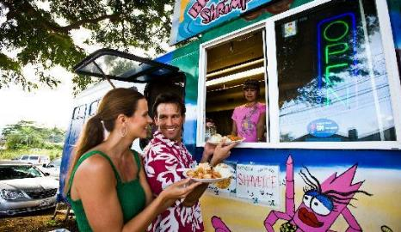
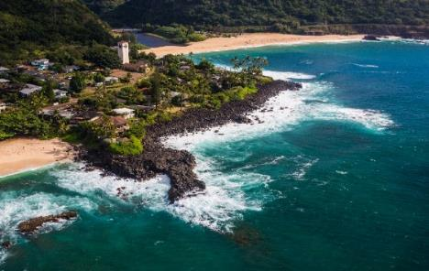
NORTH SHORE

Slide 17
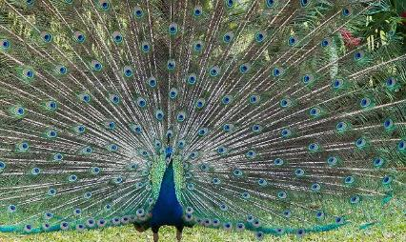
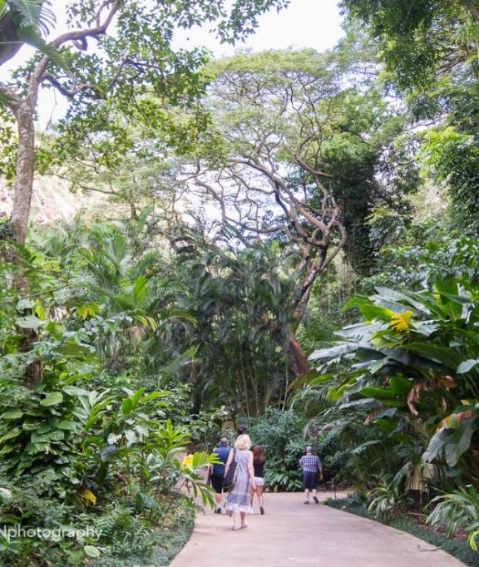
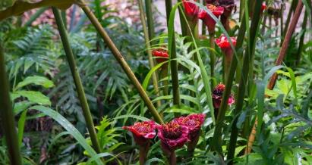
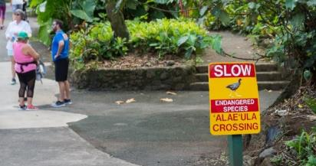
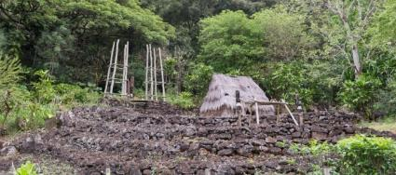
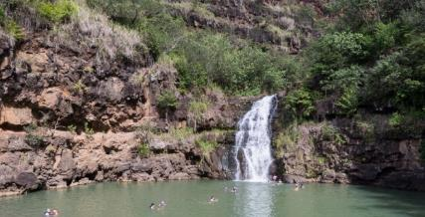
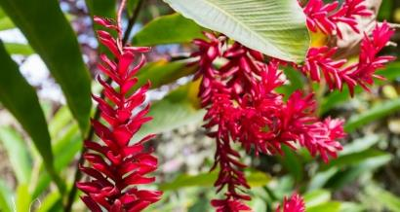
NORTH SHORE – Waimea Valley www.waimeavalley.net

Slide 18
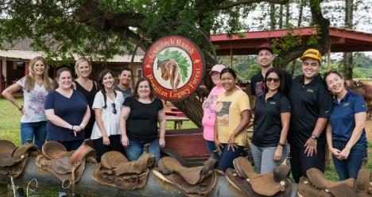
NORTH SHORE
Gunstock Ranch
www.gunstockranch.com

Slide 19
CENTRAL O‘ahu
Kō Hana Distillers
www.kohanarum.com
Agricole Rum Tours Farm to bottle |Small batch| Single variety |Hand crafted | Hawaiian Agricole Rum.
Farm | Private Tours. Tastings. Special Events

Slide 20
THE LINEUP AT
WAI KAI
www.atthelineup.com
Hawai‘i’s first deep-water standing wave | 52-acre Lagoon for water sports |Four delectable F&B options | Signature Events| VIP cabanas |Diverse event venues |Surf academy |Unique retail shop

Slide 21
MĀLAMA O‘ahu
NORTH SHORE | Hale‘iwa
CONSIDER A WEEKDAY VISIT VS A WEEKEND VISIT IF NOT STAYING ON THE NORTH SHORE
Enhancing the residents’ quality of life and improving the visitor experience

Slide 22
LEEWARD COAST
Ko Olina Resort Area
642 acres | Sweeping ocean & mountain views | String of jewel-like lagoons connected by more than a mile and a half of seaside pathways | Luxury vacation resorts| Award-winning Ko Olina Golf Club |
Ko Olina Marina - sail & snorkel - sport fishing | Dining | Shopping
Notes:
Over on the west side of the island, you find O‘ahu’s dramatic Leeward Coast, situated at the foot of the Wai‘anae Mountains. Home to the Ko Olina Resort area with Exceptional resort accommodations, championship caliber golf courses, a fantastic marina, tranquil lagoons, dining, and authentic Hawaiian lū‘au are found here.

Slide 23
Managing Environmental Impact
Why Reservations?
Reduce negative impact and destruction to the environment and ecosystem
Mālama our natural resources
Better experience for visitors and residents
Diamond Head (Lē‘ahi ) State Monument
dlnr.hawaii.gov/dsp/parks/oahu/diamond-head-state-monument
Online reservations, up to 30 days in advance
No walk-ins
Opens daily, 6am-4pm (last reservation)
Parking by reservation
Hanauma Bay Nature Preserve
Honolulu.gov/parks-hbay/home.html
1400 pax allowed each day
Online reservations, up to 48hrs in advance.
Reservations for up to 10 people per spot at a time—no more than five children and/or five adults
Wednesday-Sunday, 6am-4pm
Last entry at 1:30pm
Parking limited and first come, first serve
Lē‘ahi
Lē‘ahi
Hanauma Bay Nature Preserve

Slide 24
Paepae o He'eia
Paepae o He'eia
MĀLAMA O‘ahu
SUSTAINABLE & RESPONSIBLE TRAVEL ON O‘ahu
Sustainable tourism association of Hawai‘I
Engage with the host culture and learn about Hawaiian history. Hawai‘i is so much more than fun in the sun.
Interact responsibly with natural resources: stay on trails, take your trash out of natural areas, don’t touch reefs or marine life
Take part in voluntourism activities with O‘ahu-based groups
Look for ecotourism outfitters with the STAH seal of approval.
Use reef safe sunscreen
Bring or buy, and then use a reusable water bottle.
Clean your shoes before hiking to inhibit the spread of disease and invasive species into Hawai‘i’s natural habitats.
Look for locally sourced food options
Gunstock Ranch

Slide 25
HIKING RESOURCES
Nā ALA HELE
Hawai‘i TRAIL AND ACCESS SYSTEM
https://hawaiitrails.hawaii.gov
The State of Hawai‘i Trail and access program

Slide 26
Hike Smart When You #VisitOahu
Know Before You Go: Take a Hike and Track Yourself.
Developed by the Department of Land and Natural Resources (DLNR)
Official information about trails and other outdoor recreation spots
Users can download trail or route before heading out
The app will continue to provide their location through the phone’s GPS throughout the hike — even if cell service drops.
The information updated by the state agency’s staff - users can know which areas and trails can be legally and safely accessed
OUTERSPATIAL APP
dlnr.hawaii.gov/dofaw/app
Notes:
“Town & Country”
The most amount of swimmable beaches in the entire state of HI – over 123miles of swimmable coastline

Slide 27
FARMERS MARKETS
Hale‘iwa Farmers Market
(located at Waimea Valley)
Thu 2:00pm – 6:00pm
International Marketplace
Thu 4:00pm – 8:00pm
Market at Ka Makana Ali'i
Wed 3:00pm – 7:00pm
Sun 11:00am – 3:00pm
Pearlridge Farmers Market
(Uptown by Macy’s)
Sat 8:00am-12:00pm
Kaka‘ako Farmers Market
1050 Ala Moana Blvd
Sat 8:00am-12:00pm
Kapi‘olani Community College Farmers Market
Sat 7:30am – 11:00am
*Subject to change*

Slide 28
Native Hawaiian Signature Events & Festivals
www.gohawaii.com/events
Prince Kūhiō Festival: March 2024
www.PrinceKuhioFestival.com
Annual King Kamehameha Celebration: June 2024
http://ags.hawaii.gov/kamehameha/
Annual Prince Lot Hula Festival:
July 2024
www.moanaluagardensfoundation.org
Aloha Festivals – September 2024 www.AlohaFestivals.com
*Please check festival websites for event updates*

Slide 29
TRAVEL ADVISOR RESOURCES
Website: visit-oahu.com
Ongoing Events: gohawaii.com/events
Travel Advisors: agents.gohawaii.com
Twitter: twitter.com/OahuVB
Facebook: facebook.com/oahuhawaii
Instagram: @oahuVB
Hashtag: #VisitOahu

